Slide 1
Cassandra project
Corso Fondamenti di sistemi informativi

Slide 2

Apache Cassandra system

Slide 3
Why Cassandra
RDBMS does not work and scale well for big data:
Replication: ACID does not hold anymore
Third Normal Form doesn’t scale
Unconsistent result
Queries are not predictable
Users want a fast system
Must denormalize data
Avoid disk seek
Sacrifice disk space to accept redundancy
Client
Master
Slave
Replication lag
Sharding is a nightmare
High availability is apparent
Joins and aggregation are off limits
Data is scattered in shardes
Using 2’ indexes hit every shard
Add a shard is painful: manually move its assigned data
Edit every shard manually in case of schema changes
If a master fails, its slaves are useless until the master is up again
Manage multiple data centers is a disaster
Frequent downtime
Changes to DB settings
Updates
Drive or power supply failures
Client

Slide 4
What is Cassandra?
Cassandra is a fast distributed database built for high availability and linear scalability
Features:
Predictable performaces: low latency and high scalability, even using 2, 10, 1000 nodes
No single point of failure: it’s a peer-to-peer technology, no master/slave
Supports multi data centers: it can withstand an entire data center failure
Commodity hardware: using many low-cost machines to scale horizontally and not vertically
Easy to manage operationally
NOT a direct replacement for RDBMS: it is necessary to adapt the model
Notes:
Apache cassandra è un database distribuito veloce costruito per alta disponibilità e scalabilità lineare. Vogliamo avere performance prevedibili dal bd, bassa latenza e scalabilità: quando scaliamo con 2 100 1000 nodi abbiamo le stesse performaces. Non esistono singoli punti di fallimento: peer to peer, non ci sono master slaves o relazioni tra nodi. Possiamo riuscire a sopportare il fallimento di un intero data center. Usiamo tante macchine a basso costo: scalare orizzontalmente e non verticale.
Facile da manterere anche se i nodi crescono. Non è un sostituito diretto di un rdbms, si deve lavorare un po’

Slide 5
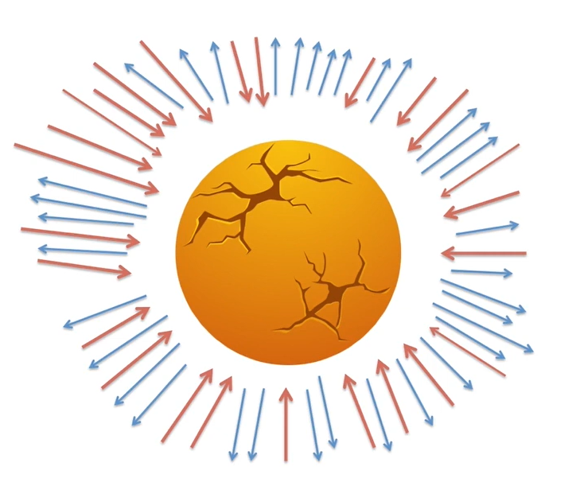

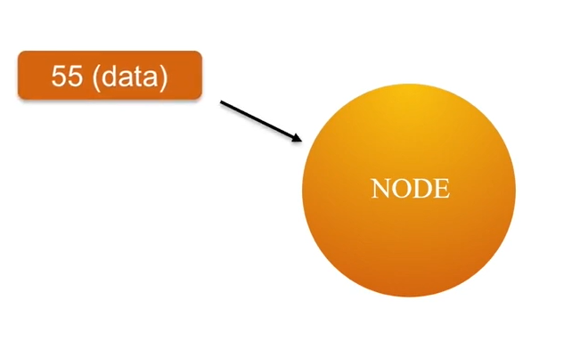
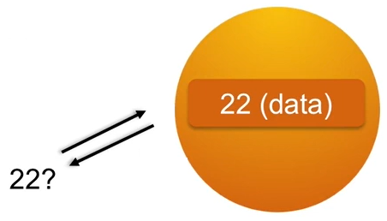
Nodes
Cassandra is a distribuited system made up of nodes. Cassandra runs in every node in a JVM (Java Virtual Machine)
Typically, a node runs on a single commodity machine or VM
A node is responsible for the data that it stores
All the data is stored in a distribuited hash table, and the data itself is hashed
When the load becomes too heavy, we just add more nodes
Write operation: the data key is 55
Read operation: the data key to find is 22

Slide 6

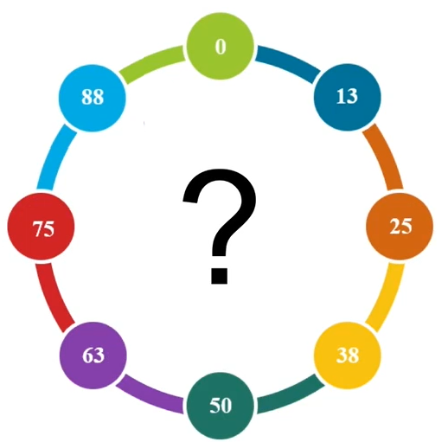
ring
Every node manages its own data: what happens when a new record comes?
New data comes to a node, that will become the coordinator that handles the request
Every node can be a coordinator
The coordinator node sends the data to the correct node that stores the partition
How does a node know where to send the data? Each node is responsible for a range of data: token range
Then when the data is sent, the coordinator sends an acknowledge to the client
59 (data)

Slide 7
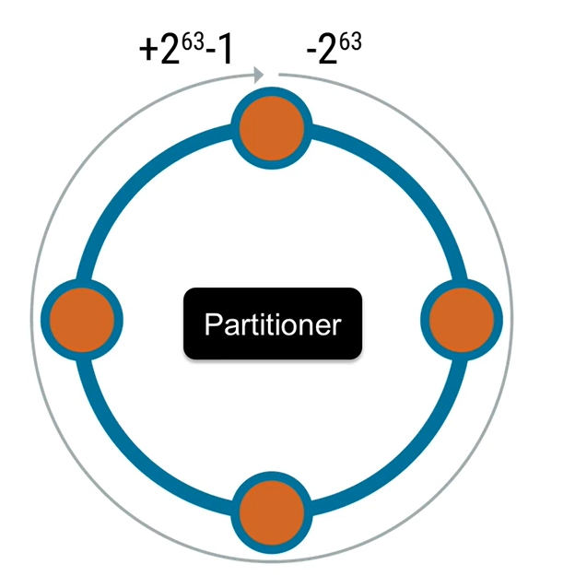
Ring
The real range goes from -2⁶³ to 2⁶³-1
How are the token distribuited?
The partitioner determines how the data is distributed across the ring
If it gets mess up, data will land to hotspots in the ring: some nodes will be overloaded and some not
Using an appropriate hash function is important for distribution, like MD5
Example of overload

Slide 8
Joining the cluster
Nodes join the cluster by communicating with any node
Other nodes calculate where it fits in the ring and streams their data to the new node
There are 4 states to each node: joining, leaving, up and down
When the node is in joining mode it is still receiving data, but it is not fully joined, so not ready for reads
The node is online! No downtime
Finally, when the node is up, it is ready
Remember: horizontal scaling is preferable, so adding nodes is good practice rather than improve a single machine

Slide 9
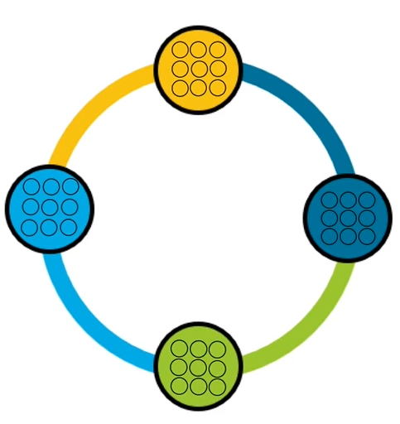

Vnodes
Adding or removing nodes in the cluster takes time to stream the data and calculate the new ring range
Using Vnodes, each physical node act like several smaller virtual nodes
A node is responsible for several smaller slices of the ring instead of one large slice
Using a consistent hash ensure that all the nodes will have the same amount of data
When a node is inserted: instead of taking over one node’s entire token range, it takes several smaller ranges from each other nodes, that will stream in parallel
Without VNodes
With VNodes

Slide 10
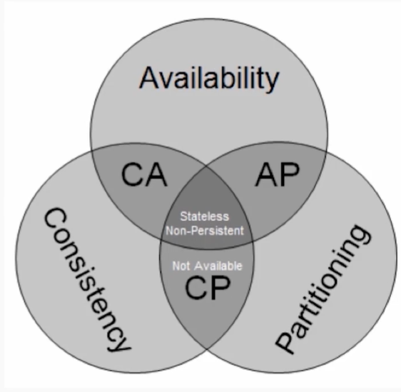
CAP tradeoffs
Impossible to be consistent, available and have network partitions
Latency between data centers makes consistency impractical, especially when they are in different continents
Cassandra chooses Availability and Partition tolerance over Consistency
However, consistency and availability are tunable

Slide 11
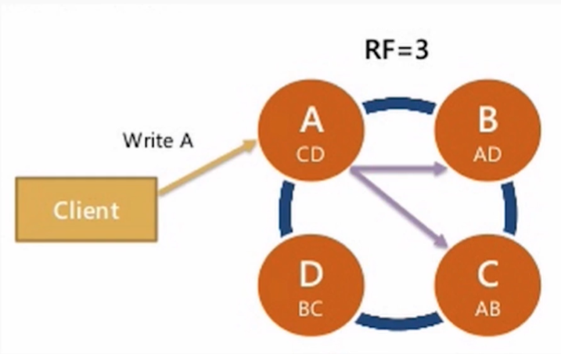
Replication
Replication factor = RF = how many copies of each piece of data should be in the cluster
- Data is replicated automatically based on the RF
- Data is always replicated in Cassandra
- Replication happens asynchronously and if a machine is down Cassandra has hinted handoff to replay the missed replication when the node is available again
A usual RF is 3
With RF = 3, when a write happens:
A node gets a copy
B node get a copy
C node gets a copy
For a total of 3 replicas

Slide 12
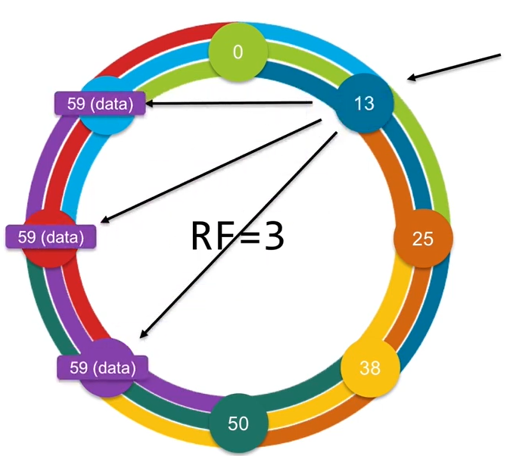
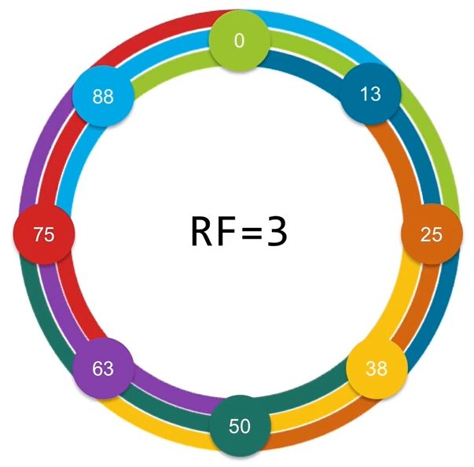

Replication
In case of RF = 3, each node has the neighbor neighbor neighbor data
This data is findable by the coordinator: when writing into the ring we know that is going to be in the right place
Replication also works well with multiple data centers

Slide 13
Tunable Consistency
Consistenct level = CL = how many replicas I need to hear when I do a read or a write before the operation is considered successful
How many replicas for query to respond OK to the client
Defines a query consistency
Two separate values: one for write and one for read
High CL: high consistency but slower, low availability Low CL: low consistency but faster, high availability
In case of read: how many replicas I need to hear before Cassandra gives the data back to the client
In case of write: how many replicas need to say that the data is written to disk before Cassandra replies to the client
Notes:
Si sceglie per sia letture che scritture

Slide 14
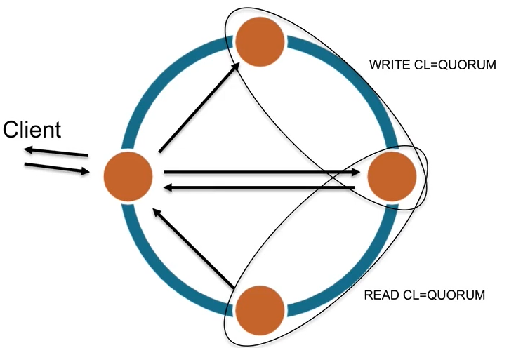
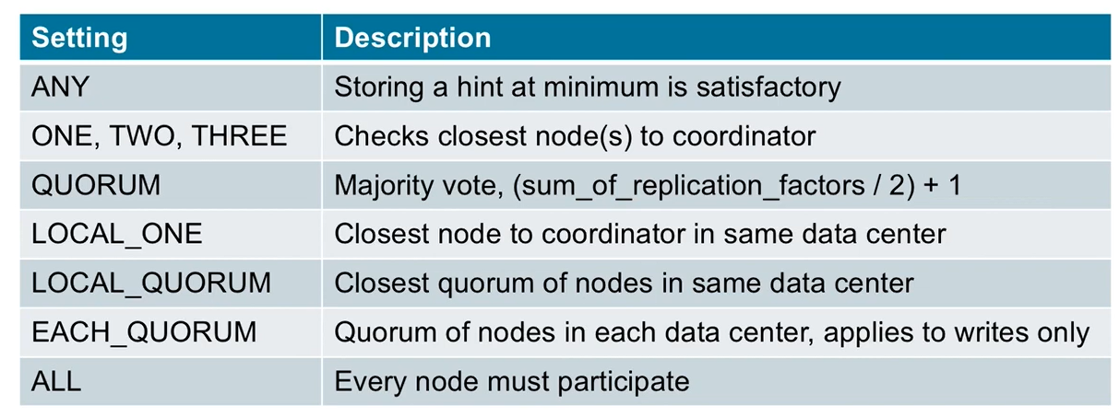
Consistency levels
When using a database, we want strong consistency
It means that we are reading the data that we just put in the cluster
A good place to start is using CL=QUORUM in reads and writes: at least 51% of nodes have to acknowledge the succeeded write or have to return the requested data

Slide 15

Gossip protocol
Gossip is a broadcast protocol for disseminating data across the cluster
Since there isn’t a central server, the peers spread information among themselves
They automatically mantain only the last information
At the end, the entire cluster know the information
Gossip does not cause a heavy amount of traffic

Slide 16
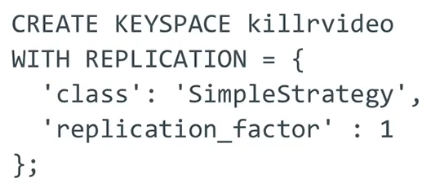

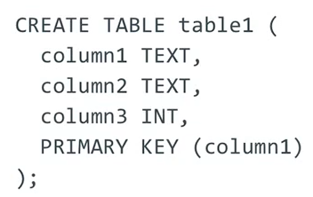
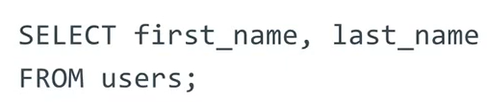
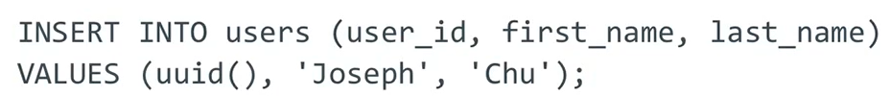
CQL
CQL is the Cassandra Query Language
Very similar to SQL
Keyspaces are similar to SQL schemas and they serve as namespaces that contains tables
Specifies the replication factor
USE command to switch between keyspaces
The rest of the commands are pretty straight-forward if coming from SQL

Slide 17
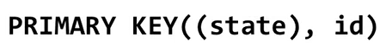
Primary key
Primary keys are important in relational databases
But in Cassandra they are the most important part of a data model
In Cassandra, a Primary key is composed of:
Partition key(s) – Tells the system in which node is the record
Clustering key(s) – Tells how to order the data that is in the same partition
The first parentheses contain the Partition key(s)
Outside the parentheses there are the Clustering keys: the order is important since in case of equal values in the first clustering key the records are ordered using the second clustering key and so on (if they exist)

Slide 18
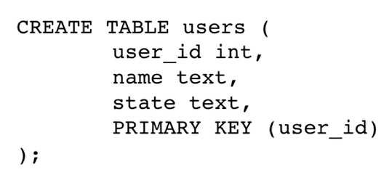
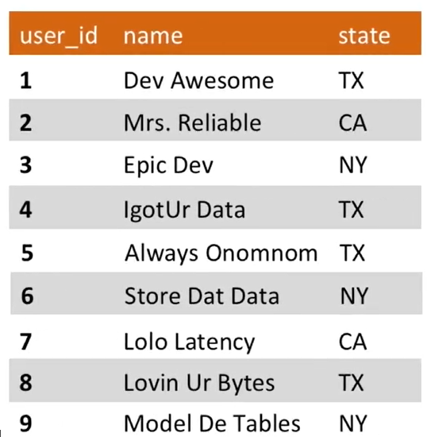
Partitions and partition keys
A Cassandra table is similar to a relational DB table
Notice the Primary key: in Cassandra we want to have fast reads and writes, and to do so we introduce Partition keys
A partition key works as a primary key but also tells the system how to group the data together.
Partitioning correctly is crucial: Cassandra knows exactly where is the partitioned data
Cassandra is application-oriented: to take advantages of its grouping it is necessary to change the data model
Partitioning by user_id is useless since it is an unique field

Slide 19
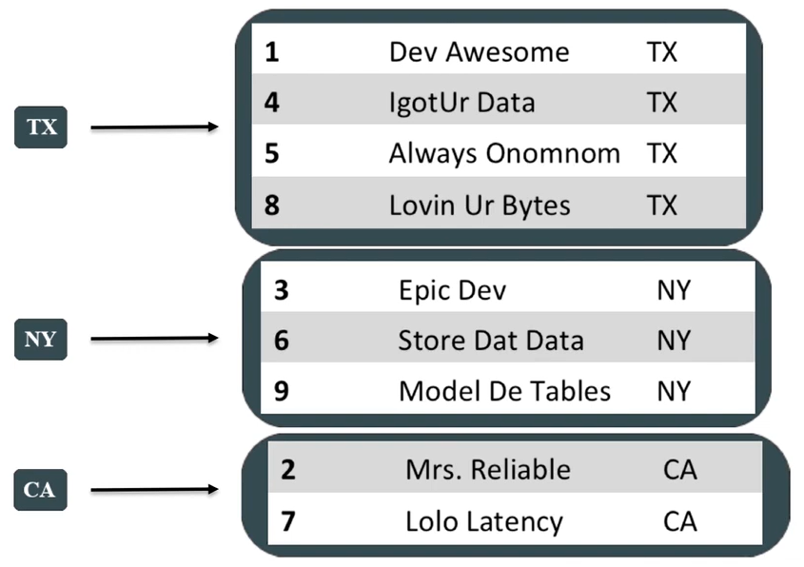
Partitions
In this example, we want to partition by the State field
The query needs to have the State as the logical grouping.
The partition key is how the data is placed on the ring. The key is hashed to determine where to place the data Same partition key = same node = same hash
The choiches made in the data model have a huge impact in the query efficency
To partition like the image, the primary key is:
where the first value is always the partition key. To make a unique primary key, the id is added as clustering column

Slide 20
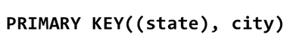
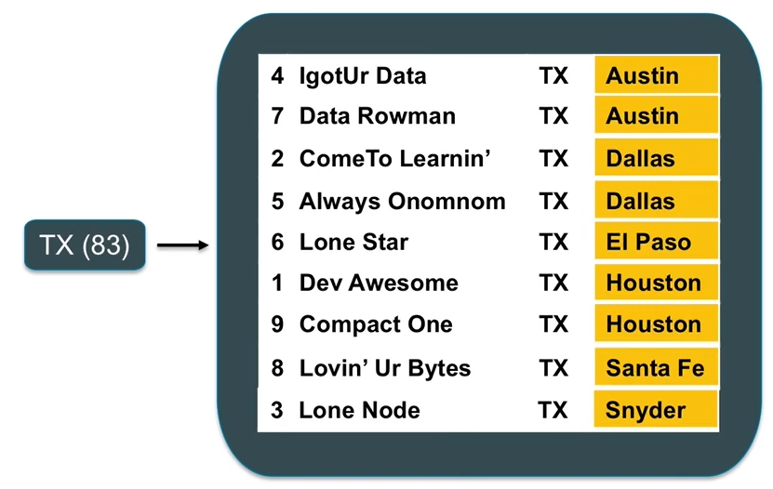
Clustering columns
Clustering columns are the second part of a primary key, and the come after the partition key.
Clustering columns tells Cassandra how to order and put data inside a partition
When writing, data is going into the disk in the order specified by the clustering columns When reading, Cassandra knows exactly where and in what order it is
It is possible to have more than one clustering column.
If it’s the case, the data is ordered by the first key, then by the second one and so on
The State is the partition key and the City is the clustering column, which is being used to sort the data from TX in ascending order

Slide 21
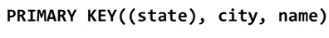
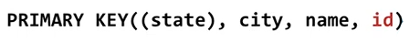
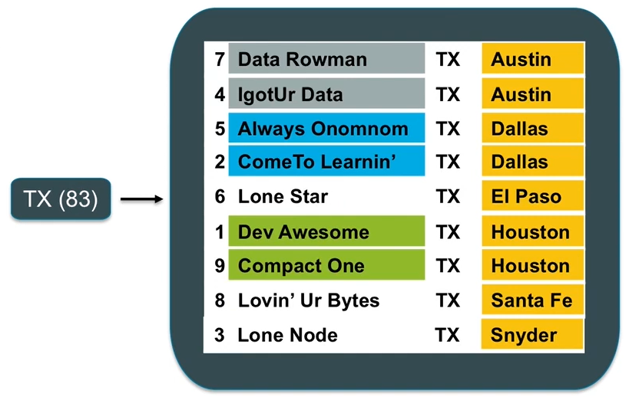
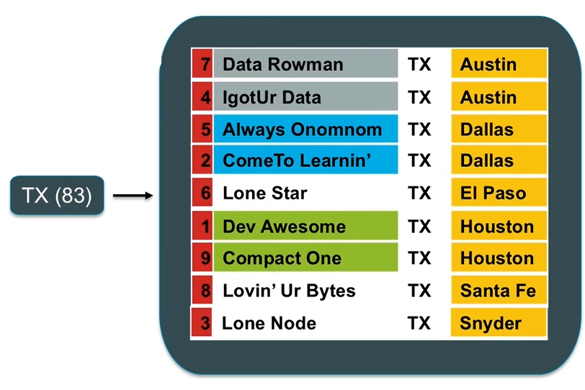
Clustering columns examples
The State is the partition key, the City and the Name are the clustering columns. First order by the city and then order by the name
To make a unique Primary key it is necessary to add a field, the id, which is in the clustering columns (Note: ids are not suitable for distribuited systems, it is better to use uuids)

Slide 22
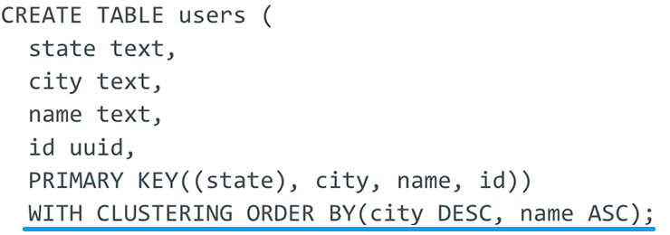
Clustering columns order
The default clustering column order is ascending
It is possible to change the order using WITH CLUSTERING ORDER BY

Slide 23
Querying
Every query should have a partition key: Cassandra needs to know where to look
Inside a partition, you can perform operations (< > =) on clustering columns
When doing equals, it is important to do them in the same order that the clustering columns are presented in the Primary key definition
That is because the data is ordered on disk: Cassandra performs a binary search
If you try to query data and filter it using a WHERE statement by NOT specifying a Partition key, Cassandra will refuse the query
If the Partition key is composed, it is necessary to provide both of them

Slide 24
Apache Cassandra data modeling

Slide 25
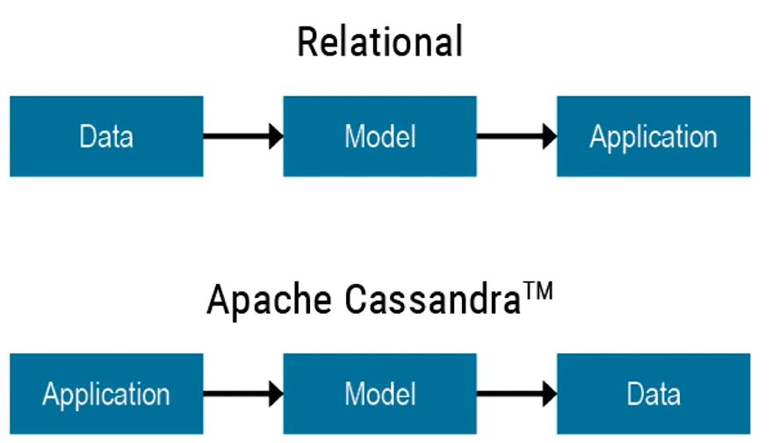
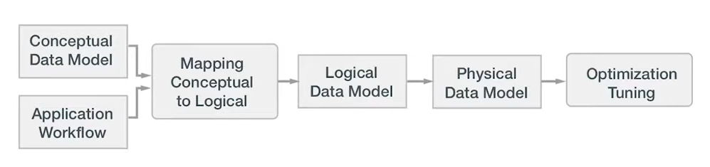
Data modeling
When designing a data model in a relational approach, you begin with the data:
Create a data model
Then think about the application
The cassandra approach is the reverse:
Think about the needs of the application first
Then use that to derive the model
Optimization tuning is not covered here
Cassandra data modeling methodology

Slide 26
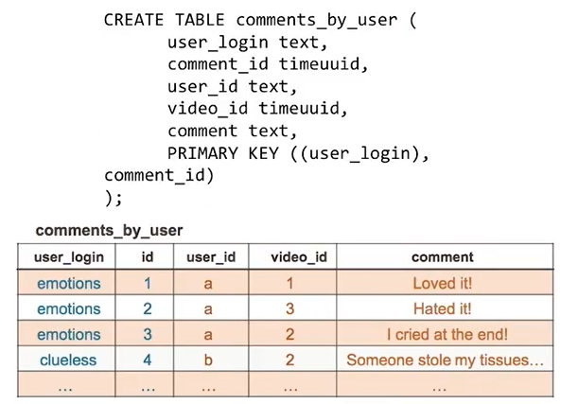
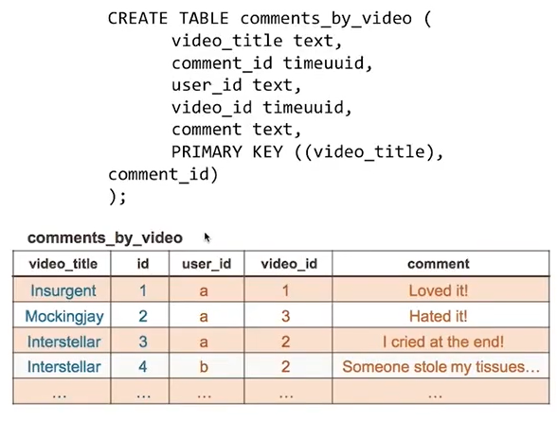
(not) Joins
A join is an operation that performs well when all the relevant data is available on a single node
But in distributed DB the data is spread across several nodes
This leads to impredictable impact on latency
That is why joins are NOT supported in Cassandra
Let us suppose that our application wants to access comments in two ways:
By user – user is the partition key
By video – video is the partition key
To support this design in Cassandra, 2 tables are created
Note: both tables have the same data, but are organized in different ways!

Slide 27
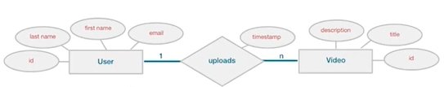
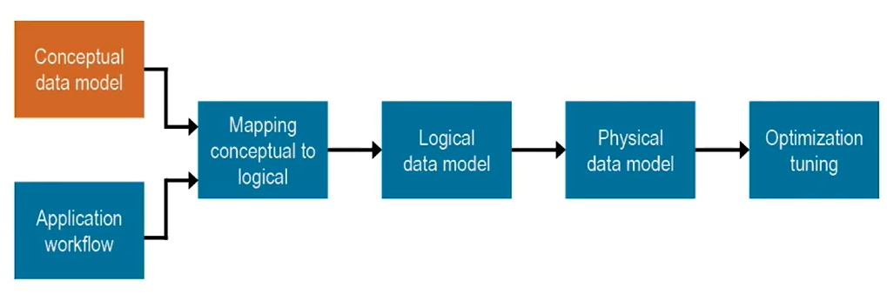
Conceptual data modeling
A conceptual data model is an abstract view of the domain
It is technology independent
Not related to any database system
It can be drawn in UML or ER
No big deal: the same as relational databases
An ER diagram
Cassandra data modeling methodology

Slide 28
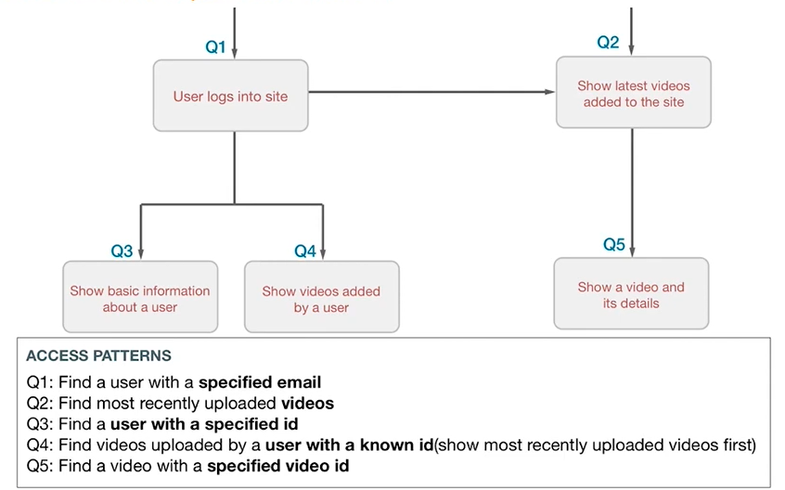
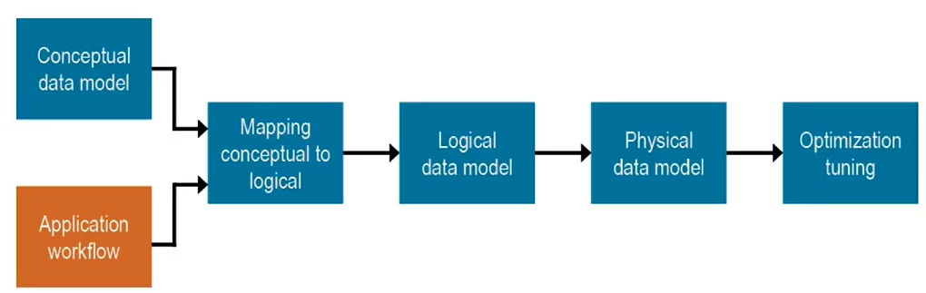
application workflow
We need to specify how users will use the system
Trace an application workflow to determine which query to perform against the DB Cassandra is query-driven
Each application has a workflow
Cassandra data modeling methodology

Slide 29
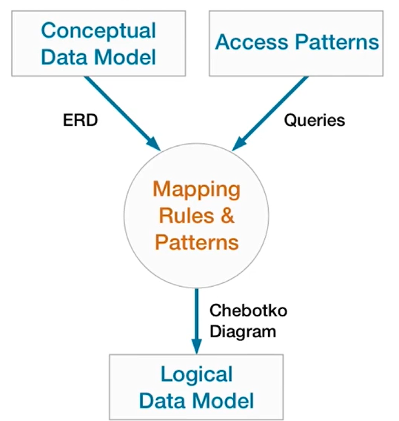
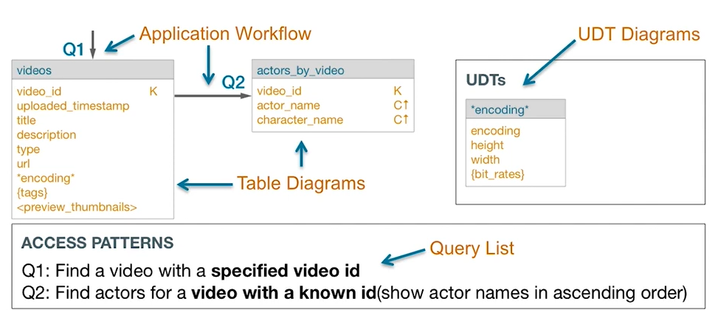
Mapping conceptual to logical
The mapping takes both the conceptual data model and the access pattern
It creates a logical Data Model, called «Chebotko diagram»
Chebotko diagram – logical view

Slide 30
Mapping rules
This process is cyclic for every query, considering the app workflow and the conceptual model
Entities and relationship
See what entities and attributes you need to satisfy the given query and combine them in a single table
Equality search attributes
Find the partition key on which the query will search for equals – the attributes used to make an ‘equals’ query
Inequality search attributes
Find on which attributes you will perform < and > searches – they will become clustering columns
Ordering attributes
Deciding the ordering of the clustering columns (ASC or DESC)
Key attributes
In case the primary key is not unique, add the needed attributes to make it distinctive

Slide 31
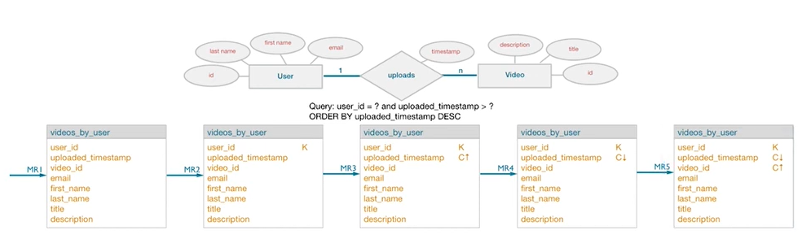
Mapping rules example
In order, the 5 tables after applying the mapping rules:
entities and relationship, equality search attributes, inequality search attributes, ordering attributes, key attributes

Slide 32
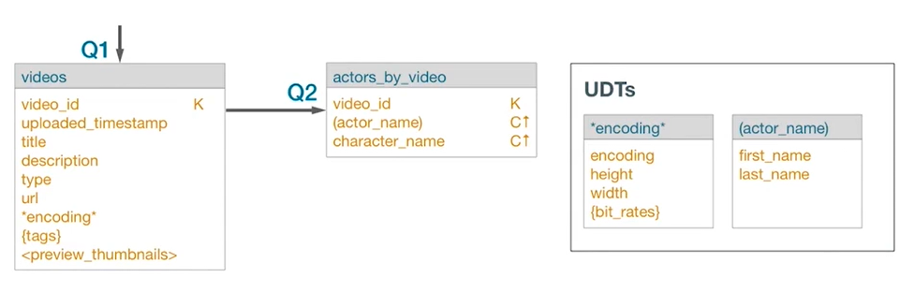
Logical data model – chebotko diagrams
https://www.researchgate.net/publication/308856170_A_Big_Data_Modeling_Methodology_for_Apache_Cassandra
Very similar to the application workflow, but with tables
Queries lead into a table that satisfies it
Partition and clustering keys have a letter next to them:
K = partition key
C = clustering columns - ↑ ascending order - ↓ descending order
Note: UDT tables are nested into other tables to define a custom data type, hence they do not have a primary key
Chebotko diagram – logical view

Slide 33
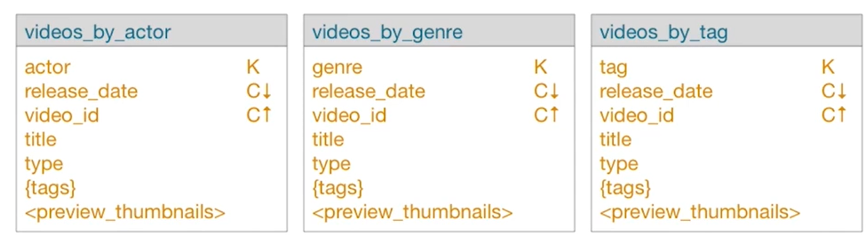
Logical data model - duplicates
Joins on read in Cassandra does not exist:
We want to grab the data and directly return it to the application
Instead, we join on write
When performing a write we materialize the join on disk, so it is optimal on read
Joining on write creates duplicated data but it is OK! We want fast read access Every update needs to edit all the involved tables
Three tables that represent a video but organized differently

Slide 34
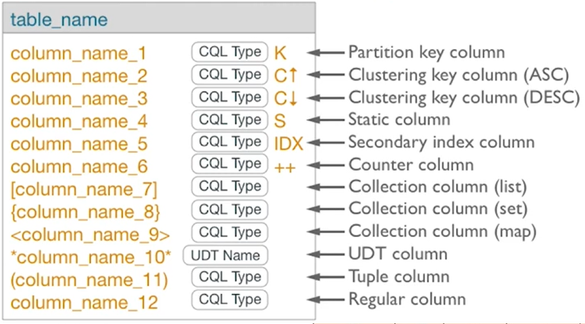
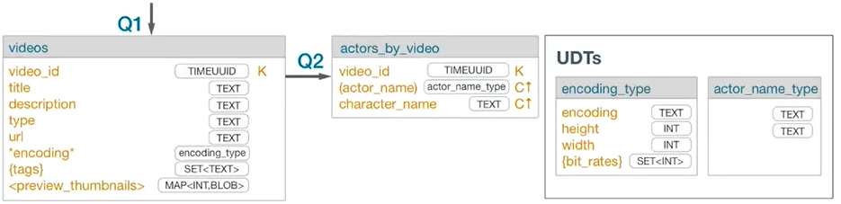
Physical data model
To move from a logical model to a physical one we just need to add the CQL data types
Remember: we preferably want to create a table that satisfies the query by executing once
Physical data model – Notice the added data types

Slide 35
VRCard project using cassandra

Slide 36
Specifications
Find the average visit time for each Point of interest (POI) in the city of Verona among «Verona Card» users
Users swipe the «Verona Card» badge when entering the POI, but not when leaving it.
We can estimate the visit time of a POI by crossing two entrance times of the same user: the first entrance time is from the considered POI, and the second entrance is from the next POI visited by the user
It is obvious that it is not possible to know the visit time of the last user’s visited POI
Moreover, we need to consider the travel time between two POI and subtract it from the visit time: a user needs to move around to go from a POI to another
Also, the calculation between two POI in two different days are ignored
We could add other criterias, for example considering hours between 12:00 to 14:00 as lunch time and subtract 1 hour from the visit time if it falls in this range (however, this was not considered in the solutions)

Slide 37
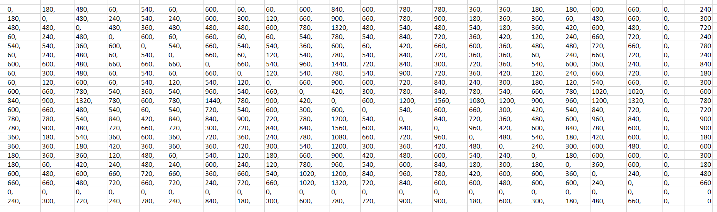
Travel time matrix
Since there are 22 POI in the database, it was necessary to manually find 22*22=484 travel times using Google Maps (shown in seconds)
However, half matrix is the same as the other half (since travelling from A to B and B to A is pretty much the same time in the city of Verona), and also the main diagonal of the matrix is excluded (travel time from A to A is 0)
Verona Card users have free access to urban bus rides, so times are calculated considering bus travels

Slide 38
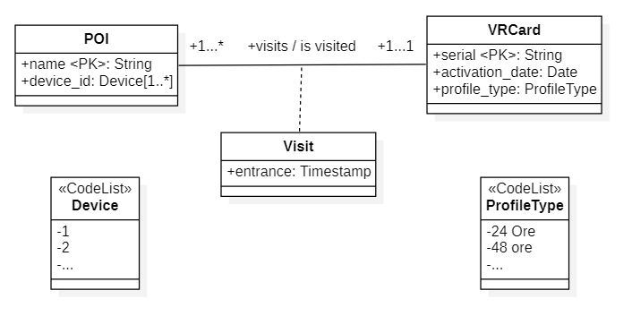
conceptual model (UML)
Note:
1…1 multiplicity on the VRCard side is because the Verona Card terms state: «With VeronaCard each museum/monument can be visited only once»
Visit is an association class
Device and ProfileType act as enumeration classes

Slide 39
Premises
As suspected, measuring the outcome of the 3 implementations of the task confirmed that Cassandra is not suitable for data analysis
As mentioned earlier, Cassandra is a data-oriented technology, that follows a precise application workflow
So is NOT suitable for data analysis
A more efficent way to solve the problem is using Apache Spark in conjuction with Cassandra
Since the project was about Cassandra and I already used Spark in the Big Data course, I tried anyway to solve the problem using Cassandra capabilities
We can use this project to confirm that Cassandra is great as an application DB, but not so good at handling data analyais
In all three solution, a Cassandra driver for Python was used

Slide 40
.csv preprocessing
Modifica dei file csv per unire data e ora, sistemazione di data in formato yyyy/mm/dd
Colonne con in e il numero tolte perché non c’era scritto cos’erano
Non servono virgolette

Slide 41
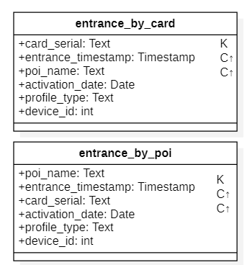
Solution 1 – Everything using Python
In this solution I wanted to use the Dataset almost as provided.
Using this schema, it is necessary to check two rows to calculate the users’ visit times
Cassandra does NOT support sub-queries
An external programming language is required: Cassandra driver for Python
The script asks for ALL the rows in the table entrance_by_card, and then calculates the visit time for each user, considering travel times and excluding different days calulations
However, asking for all the rows is not good practice
It was not possible to ask by POI in entrance_by_poi, since we need the order of the POI visited by users
Physical schema of the first solution
To be fair, only the entrance_by_card table was used. entrance_by_poi was never used: it was my first attempt and I thought it was going to be useful

Slide 42
Solution 1 – Everything using Python
Surprisingly, this solution was the fastest of the 3
That is probably because the overhead time is the query execution, while the calculating part is very fast

